Slide 1


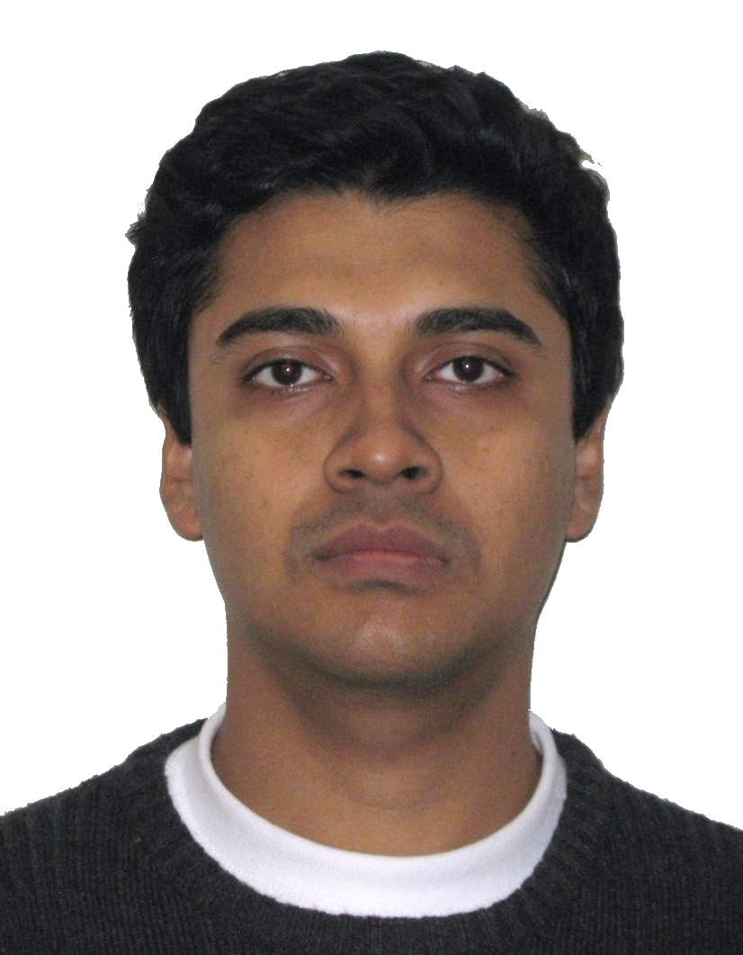


Spark
Distributed Memory Abstractions for Cluster Computing
Matei Zaharia, Mosharaf Chowdhury, Justin Ma, Michael J. Franklin, Scott Shenker, Ion Stoica
Motivation
Architecture
Interactive Spark
MapReduce & Dryad are highly successful, but use acyclic an data flow model that is not suitable for all applications
Can we provide similarly powerful high-level abstractions for a broader class of apps?
Nodes cache partitions of RDDs as requested by user
Fault tolerance achieved through lineage
RDD handles contain series of transformations needed to rebuild dataset
Cache 1
Modified Scala interpreter to allow interactive use of Spark
Bytecode analysis & code generation changes used to find dependencies for each input line
Remote class loading on slave nodes
results
Worker
Driver
tasks
Block 1
Worker
Cache 2
Worker
Cache 3
Block 2
Spark Goals
Block 3
Future Plans
Support cluster applications that reuse working sets of data, including:
Iterative algorithms
Interactive data mining
Provide automatic fault tolerance and load balancing similar to MapReduce
Ease of programming through integration into Scala language
RDD Lineage Example
// Cache an RDD containing all the
// lines with “ERROR” in a log file
file = spark.textFile("hdfs://...”)
errs = file.filter(_.contains("ERROR"))
cachedErrs = errs.cache()
// Count errors using the cached RDD
ones = cachedErrs.map(_ => 1)
count = ones.reduce(_+_)
file:
HdfsTextFile
path = hdfs://…
Extensions to RDD capabilities
Ability to control layout (column vs row oriented storage, indexing)
Configurable caching strategies
Additional transformations (driven by requirements of AMP apps)
Updatable and streaming RDDs
Unify other cluster programming models that add state (e.g. Pregel, iterative MapReduce)
Efficient large-scale implementation of common communication patterns (broadcast, shuffle, …)
Debugging tools based on lineage
Replay tasks in conventional debugger
Rebuild RDDs and query interactively
CPU and memory profiling using parallel sampling at large scales
errs:
FilteredDataset
func = _.contains(..)
cachedErrs:
CachedDataset
ones:
MappedDataset
func = _ => 1
Results
Logistic Regression Job
Interactive Response Time
Programming Model
Resilient Distributed Datasets (RDDs)
Collections of objects stored across cluster nodes that can be rebuilt on failure
Created by applying transformations (e.g. map, group by) to data in stable storage
Can be explicitly cached for reuse
Parallel operations on RDDs (reduce, etc)
Restricted shared variables (broadcast variables and accumulators)
(Full-text search on 45 GB Wikipedia dataset)
Alternating Least Squares Job

